Slide 1
Copper texture XRD Analysis SG-00005 6/7/23
EFK X-Ray Lab
T. Avbovbo,

Slide 2
SG-00005
4 wafer samples were tested to check for preferred Cu (111) orientation.
46KDN139SJB3 – Shortened to SJB3 in the report
46KDN140SJE4 – Shortened to SJE4 in the report
46KDN145SJD5 – Shortened to SJD5 in the report
46KDN143SJC4 – Shortened to SJC4 in the report

Slide 3
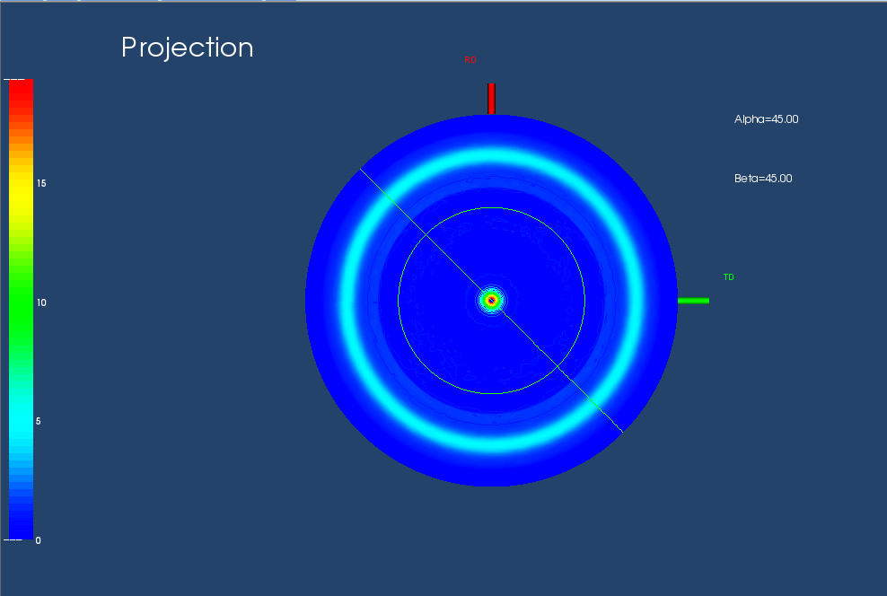
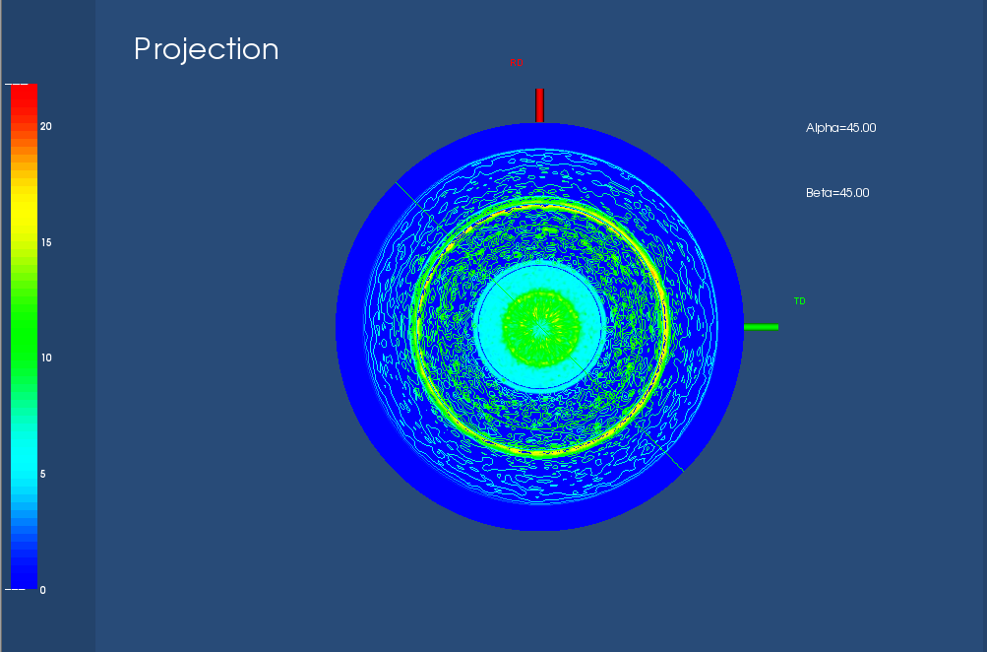
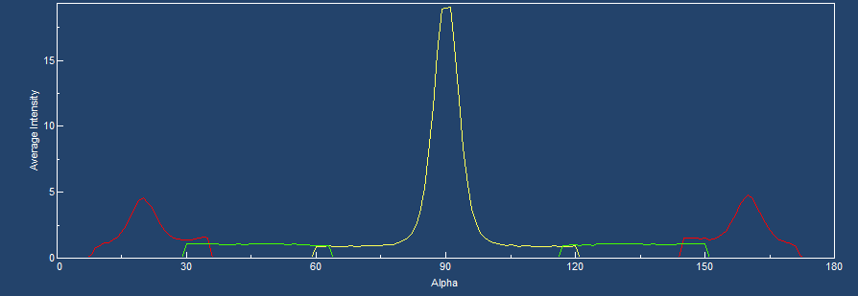
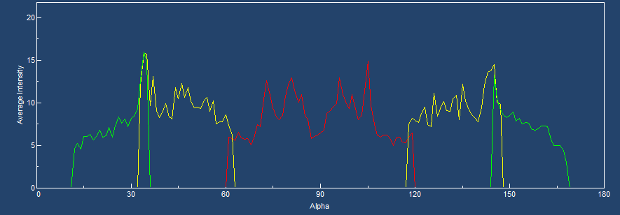
Wafer ID: SJE4
The Copper (111) planes have a preferred orientation with low intensity.
The (200) planes are randomly oriented with similar intensities as the (111) set of planes.
(111)
(200)
(111)
(200)

Slide 4
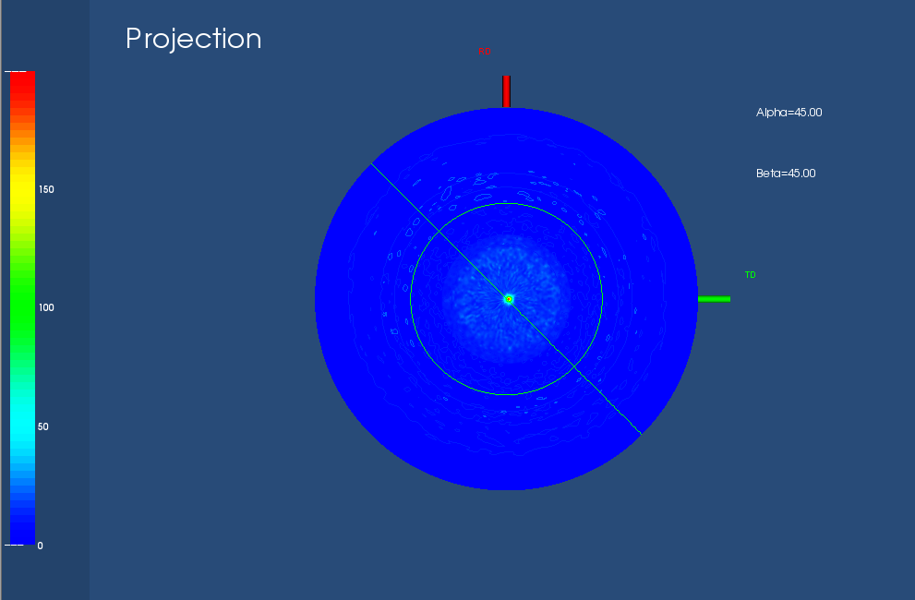
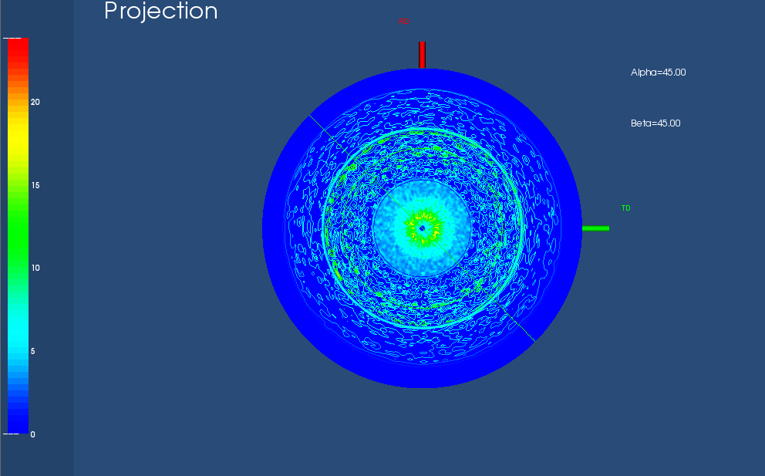
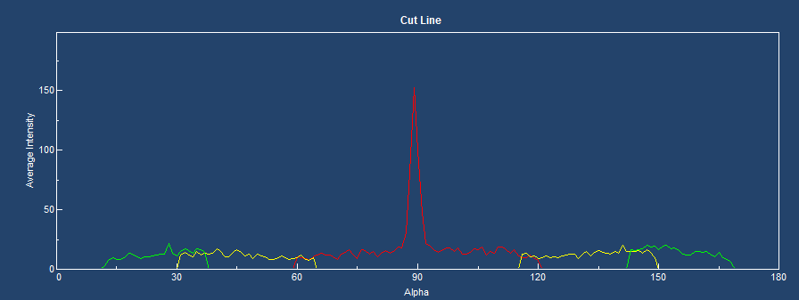
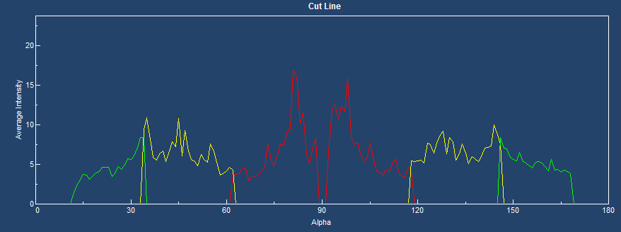
Wafer ID : SJD5
The copper (111) planes have a preferred orientation with medium intensity.
The copper (200) planes have random orientation with low intensity.
(111)
(200)
(111)
(200)

Slide 5
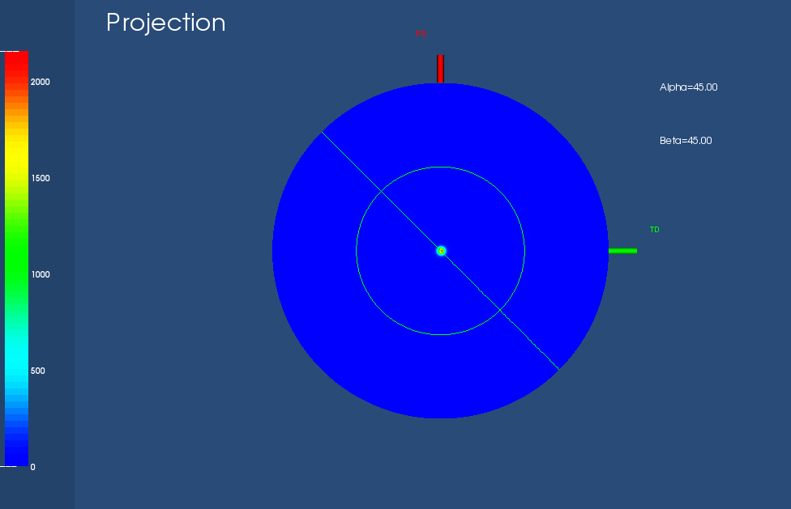
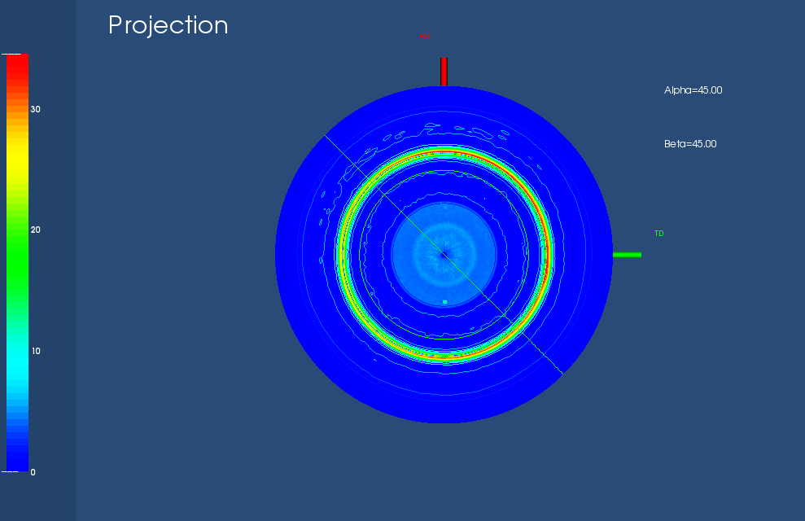
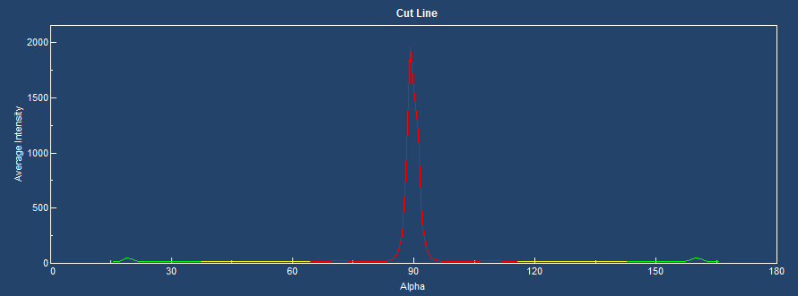
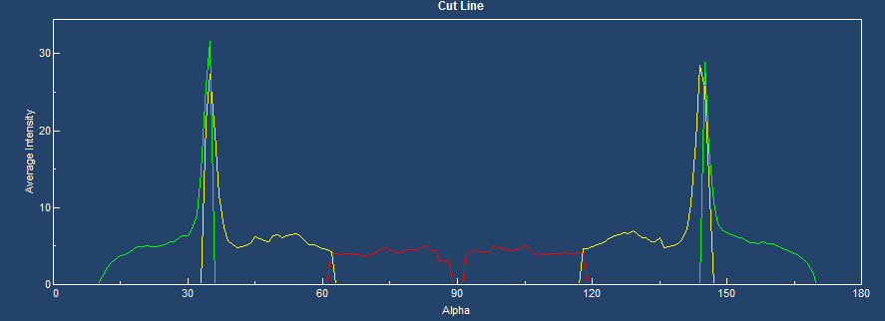
Wafer ID: SJB3
The copper (111) planes have a preferred orientation with high intensity.
The copper (200) planes have preferred orientation not parallel to the surface of the sample and low intensity.
(111)
(200)
(111)
(200)

Slide 6
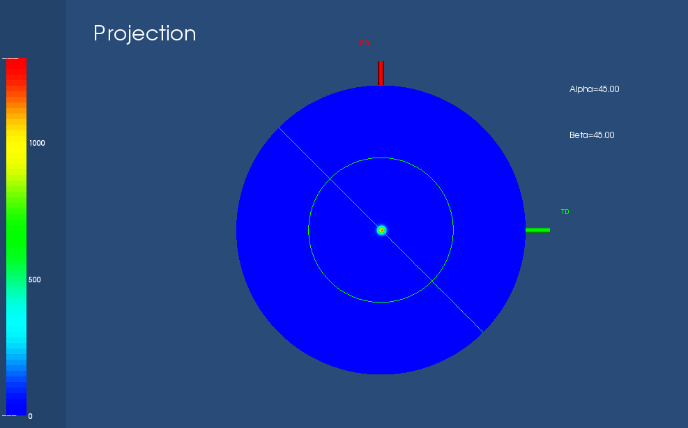
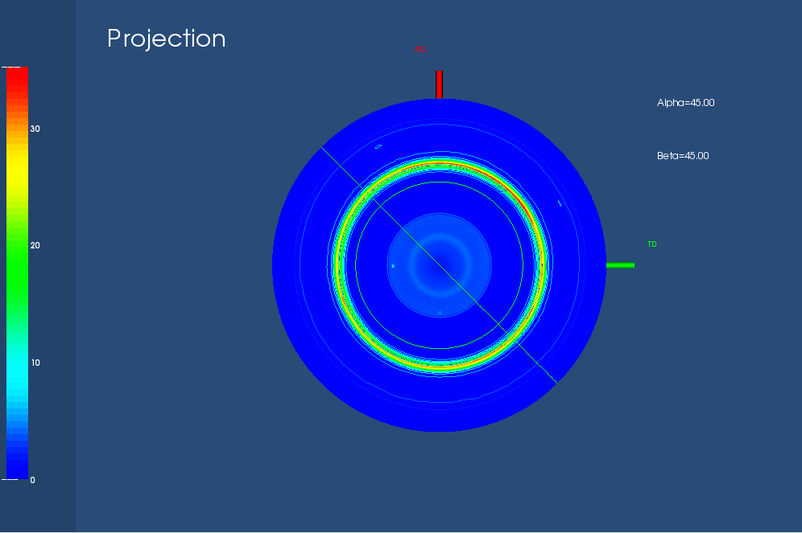
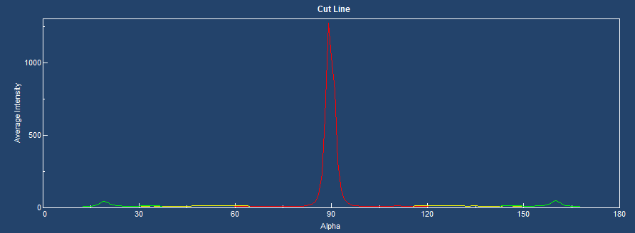
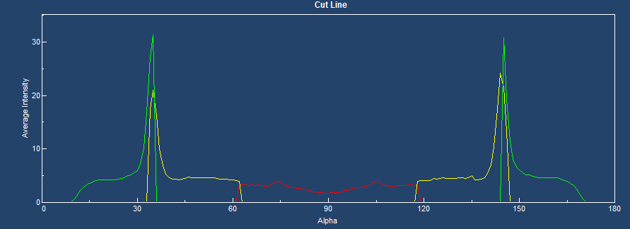
Wafer ID :SJC4
The copper (111) planes have a preferred orientation with high intensity.
The copper (200) planes have preferred orientation not parallel to the surface of the sample and low intensity.
(111)
(200)
(111)
(200)

Slide 7
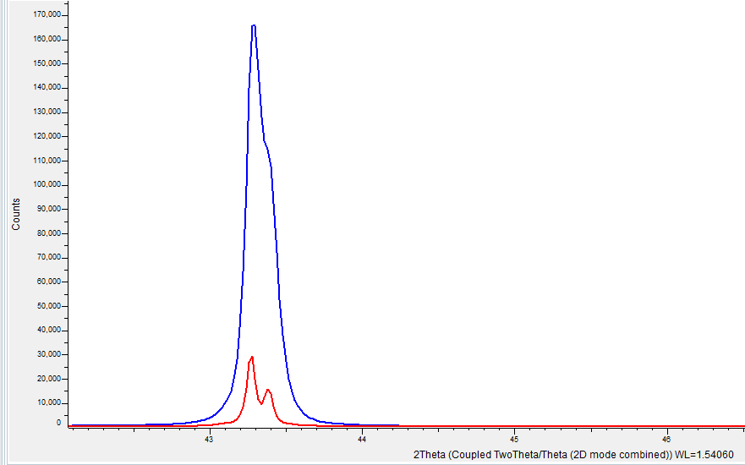
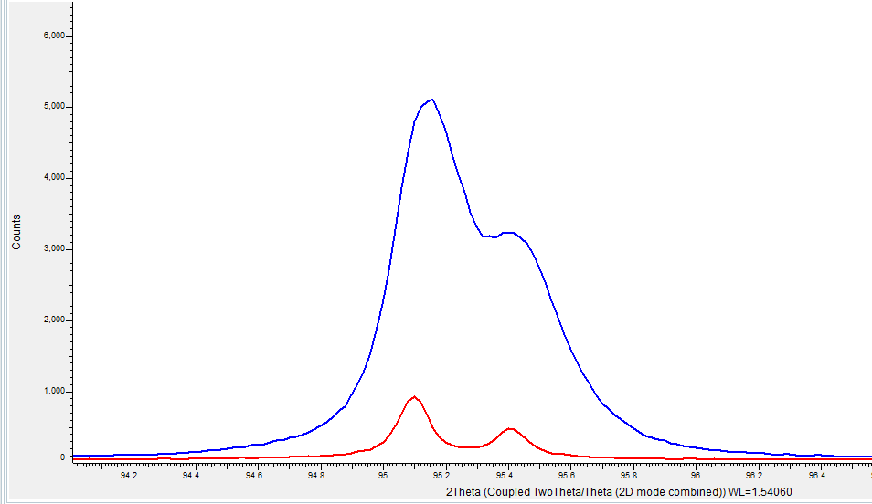
SJB3 V SJD5
The intensity of the (111) set of planes in SJB3 is 5 times greater than that of SJD5 (more (111) planes in SJB3 sample).
The intensity of the (200) set of planes in SJB3 is 5 times greater than that of SJD5 (more (200) planes in SJB3 sample).
SJB3
SJD5
SJB3
SJD5

Slide 8
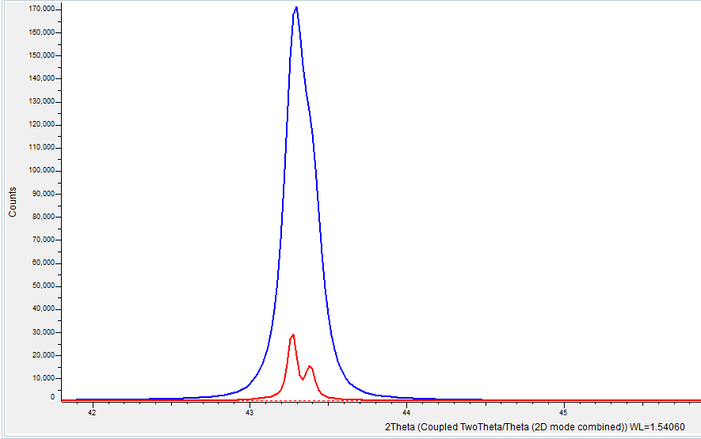
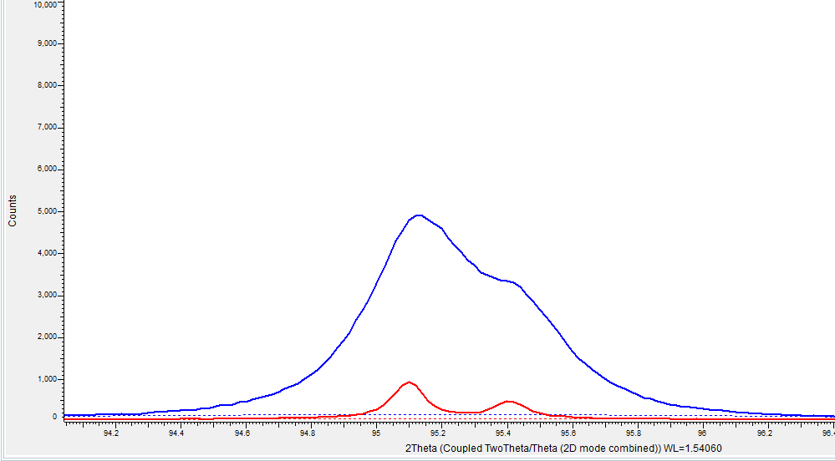
SJC4 V SJD5
The intensity of the (111) set of planes in SJC4 is 5 times greater than that of SJD5(more (111) planes in SJC4 sample).
The intensity of the (200) set of planes in SJC4 is 5 times greater than that of SJD5 (more (200) planes in SJC4 sample).
SJC4
SJD5
SJC4
SJD5

Slide 9
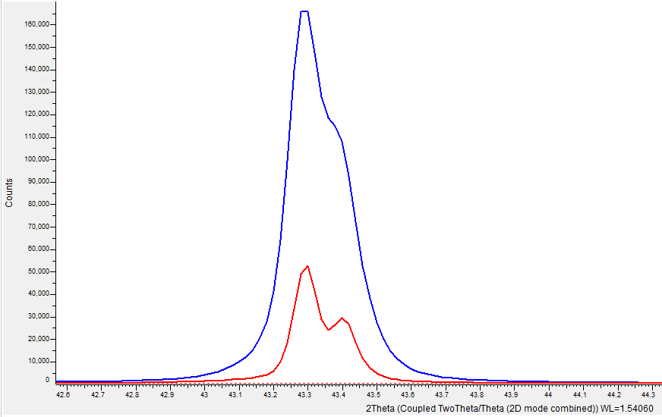
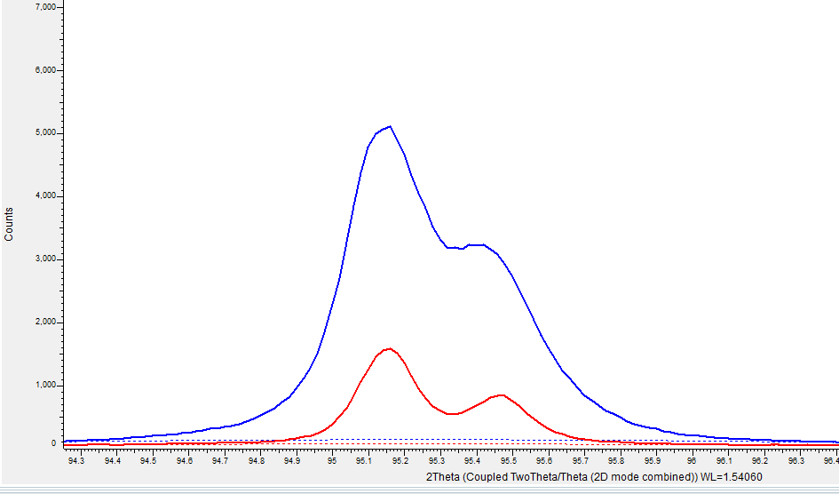
SJB3 V SJE4
The intensity of the (111) set of planes in SJB3 is 3 times greater than that of SJE4 (more (111) planes in SJB3 sample).
The intensity of the (200) set of planes in SJB3 is 3 times greater than that of SJE4 (more (200) planes in SJB3 sample).
SJB3
SJE4
SJB3
SJE4

Slide 10
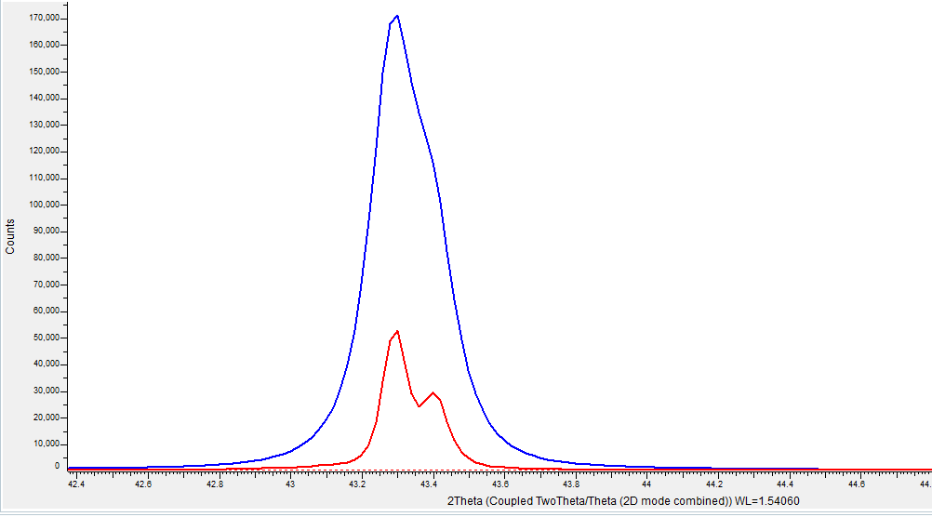
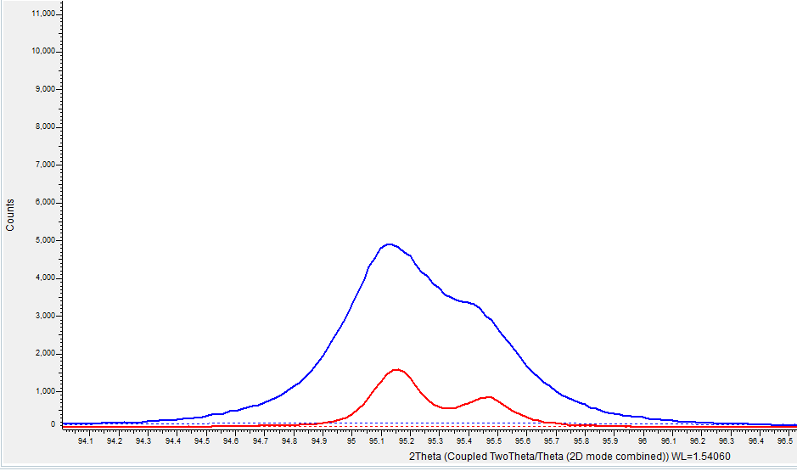
SJC4 V SJE4
The intensity of the (111) set of planes in SJC4 is 3 times greater than that of SJE4 (more (111) planes in SJC4 sample).
The intensity of the (200) set of planes in SJC4 is 3 times greater than that of SJE4 (more (200) planes in SJC4 sample).
SJC4
SJE4
SJC4
SJE4

Slide 11
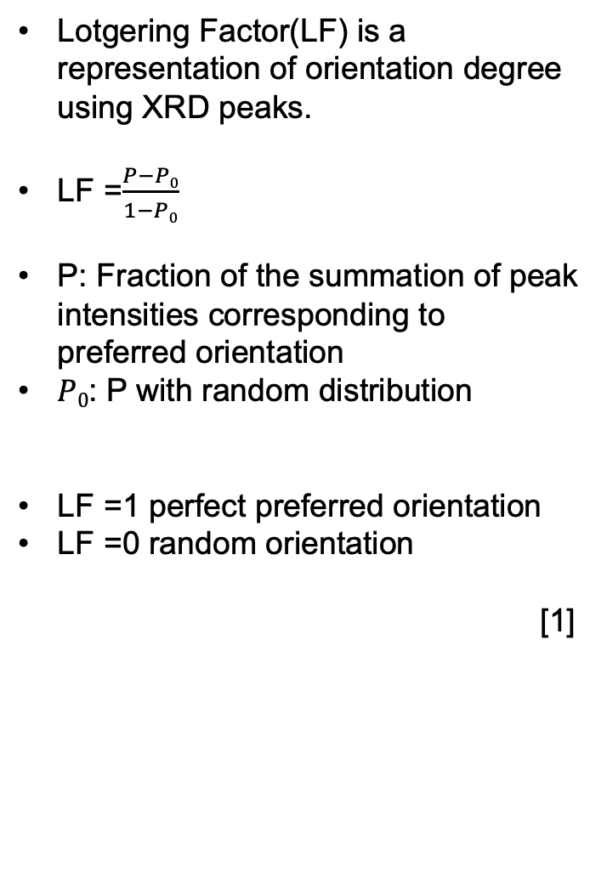
Lotgering Factor
Lotgering Factor(LF) is a representation of orientation degree using XRD peaks.
LF =$\frac{P−P0}{1−P0}$
P: Fraction of the summation of peak intensities corresponding to preferred orientation
$P0$: P with random distribution
LF =1 perfect preferred orientation
LF =0 random orientation
[1]
Wafer ID | LF
SJE4 | 0.81
SJD5 | 0.63
SJC4 | 0.93
SJB3 | 0.87
Wafer ID SJC4 has the highest degree of preferred orientation((111) plane)

Slide 12
Future Work
Use Bruker XRD to calculate volume fraction of Cu (111) planes

Slide 13
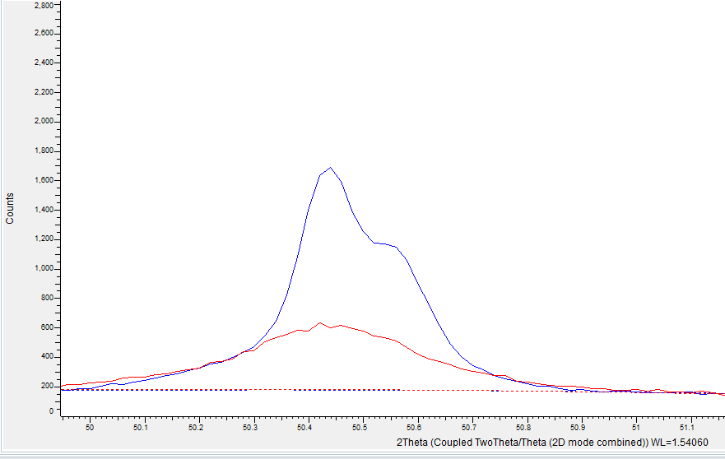
SJC4 V SJB3
The intensity of the (222) set of planes in SJB3 is 3 times greater than that of SJC4 (more 222 oriented planes in SJB3 sample).
SJB3
SJC4

Slide 14
Tilt at 90 degrees
The (111) copper planes have a high intensity parallel to the surface of sample hence the bright red spot in the center
Tilt at 0 degrees
Tilt at 90 degrees
Tilt at 0 degrees
Tilt at 90 degrees
Alpha graph shows the 111 planes are mostly oriented to the surface of the sample

